Slide 1
Word Sense Disambiguation

Slide 2
Word Sense Disambiguation (WSD)
Given
A word in context
A fixed inventory of potential word senses
Decide which sense of the word this is
Why? Machine translation, QA, speech synthesis
What set of senses?
English-to-Spanish MT: set of Spanish translations
Speech Synthesis: homographs like bass and bow
In general: the senses in a thesaurus like WordNet

Slide 3
Two variants of WSD task
Lexical Sample task
Small pre-selected set of target words (line, plant)
And inventory of senses for each word
Supervised machine learning: train a classifier for each word
All-words task
Every word in an entire text
A lexicon with senses for each word
Data sparseness: can’t train word-specific classifiers

Slide 4
WSD Methods
Supervised Machine Learning
Thesaurus/Dictionary Methods
Semi-Supervised Learning

Slide 5
Word Sense Disambiguation
Supervised Machine Learning

Slide 6
Supervised Machine Learning Approaches
Supervised machine learning approach:
a training corpus of words tagged in context with their sense
used to train a classifier that can tag words in new text
Summary of what we need:
the tag set (“sense inventory”)
the training corpus
A set of features extracted from the training corpus
A classifier

Slide 7
Supervised WSD 1: WSD Tags
What’s a tag?
A dictionary sense?
For example, for WordNet an instance of “bass” in a text has 8 possible tags or labels (bass1 through bass8).

Slide 8
8 senses of “bass” in WordNet
bass - (the lowest part of the musical range)
bass, bass part - (the lowest part in polyphonic music)
bass, basso - (an adult male singer with the lowest voice)
sea bass, bass - (flesh of lean-fleshed saltwater fish of the family Serranidae)
freshwater bass, bass - (any of various North American lean-fleshed freshwater fishes especially of the genus Micropterus)
bass, bass voice, basso - (the lowest adult male singing voice)
bass - (the member with the lowest range of a family of musical instruments)
bass - (nontechnical name for any of numerous edible marine and freshwater spiny-finned fishes)

Slide 9
Inventory of sense tags for bass

Slide 10
Supervised WSD 2: Get a corpus
Lexical sample task:
Line-hard-serve corpus - 4000 examples of each
Interest corpus - 2369 sense-tagged examples
All words:
Semantic concordance: a corpus in which each open-class word is labeled with a sense from a specific dictionary/thesaurus.
SemCor: 234,000 words from Brown Corpus, manually tagged with WordNet senses
SENSEVAL-3 competition corpora - 2081 tagged word tokens

Slide 11
SemCor
<wf pos=PRP>He</wf>
<wf pos=VB lemma=recognize wnsn=4 lexsn=2:31:00::>recognized</wf>
<wf pos=DT>the</wf>
<wf pos=NN lemma=gesture wnsn=1 lexsn=1:04:00::>gesture</wf>
<punc>.</punc>

Slide 12
Supervised WSD 3: Extract feature vectors Intuition from Warren Weaver (1955):
“If one examines the words in a book, one at a time as through an opaque mask with a hole in it one word wide, then it is obviously impossible to determine, one at a time, the meaning of the words…
But if one lengthens the slit in the opaque mask, until one can see not only the central word in question but also say N words on either side, then if N is large enough one can unambiguously decide the meaning of the central word…
The practical question is : ``What minimum value of N will, at least in a tolerable fraction of cases, lead to the correct choice of meaning for the central word?”

Slide 13
Feature vectors
A simple representation for each observation
(each instance of a target word)
Vectors of sets of feature/value pairs
Represented as a ordered list of values
These vectors represent, e.g., the window of words around the target

Slide 14
Two kinds of features in the vectors
Collocational features and bag-of-words features
Collocational
Features about words at specific positions near target word
Often limited to just word identity and POS
Bag-of-words
Features about words that occur anywhere in the window (regardless of position)
Typically limited to frequency counts

Slide 15
Examples
Example text (WSJ):
An electric guitar and bass player stand off to one side not really part of the scene
Assume a window of +/- 2 from the target

Slide 16
Examples
Example text (WSJ)
An electric guitar and bass player stand off to one side not really part of the scene,
Assume a window of +/- 2 from the target

Slide 17
Collocational features
Position-specific information about the words and collocations in window
guitar and bass player stand
word 1,2,3 grams in window of ±3 is common

Slide 18
Bag-of-words features
“an unordered set of words” – position ignored
Counts of words occur within the window.
First choose a vocabulary
Then count how often each of those terms occurs in a given window
sometimes just a binary “indicator” 1 or 0

Slide 19
Co-Occurrence Example
Assume we’ve settled on a possible vocabulary of 12 words in “bass” sentences:
[fishing, big, sound, player, fly, rod, pound, double, runs, playing, guitar, band]
The vector for:
guitar and bass player stand
[0,0,0,1,0,0,0,0,0,0,1,0]

Slide 20
Word Sense Disambiguation
Classification

Slide 21
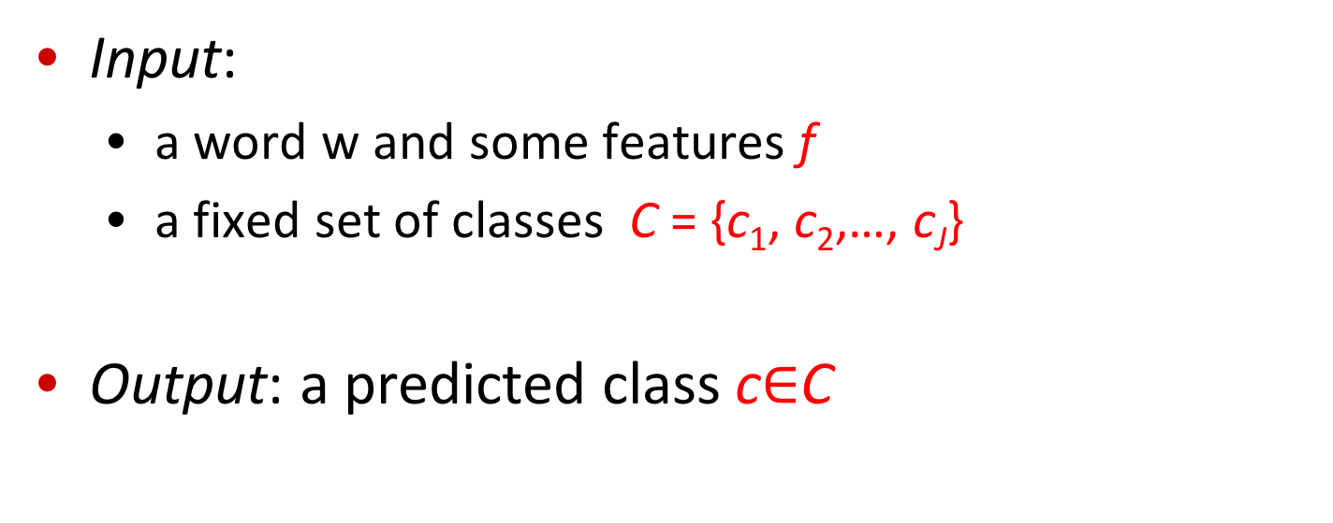
Classification: definition
Input:
a word w and some features f
a fixed set of classes C = {c₁, c₂,…, c_{J}}
Output: a predicted class c$∈$C

Slide 22
Classification Methods: Supervised Machine Learning
Input:
a word w in a text window d (which we’ll call a “document”)
a fixed set of classes C = {c₁, c₂,…, c_{J}}
A training set of m hand-labeled text windows again called “documents” (d₁,c₁),....,(d_{m},c_{m})
Output:
a learned classifier γ:d → c

Slide 23
Classification Methods: Supervised Machine Learning
Any kind of classifier
Naive Bayes
Logistic regression
Neural Networks
Support-vector machines
k-Nearest Neighbors
…

Slide 24
Applying Naive Bayes to WSD
P(c) is the prior probability of that sense
Counting in a labeled training set.
P(w|c) conditional probability of a word given a particular sense
P(w|c) = count(w,c)/count(c)
We get both of these from a tagged corpus like SemCor
Can also generalize to look at other features besides words.
Then it would be P(f|c)
Conditional probability of a feature given a sense

Slide 25
 | Doc | Words | Class
Training | 1 | fish smoked fish | f
 | 2 | fish line | f
 | 3 | fish haul smoked | f
 | 4 | guitar jazz line | g
Test | 5 | line guitar jazz jazz | ?
Priors:
P(f)=
P(g)=
V = {fish, smoked, line, haul, guitar, jazz}
3
4
1
Choosing a class:
P(f|d5)
P(g|d5)
4
3/4 * 2/14 * (1/14)² * 1/14
≈ 0.00003
Conditional Probabilities:
P(line|f) =
P(guitar|f) =
P(jazz|f) =
P(line|g) =
P(guitar|g) =
P(jazz|g) =
(1+1) / (8+6) = 2/14
(0+1) / (8+6) = 1/14
1/4 * 2/9 * (2/9)² * 2/9
≈ 0.0006
(0+1) / (8+6) = 1/14
(1+1) / (3+6) = 2/9
(1+1) / (3+6) = 2/9
(1+1) / (3+6) = 2/9

Slide 26
Word Sense Disambiguation
Evaluations and Baselines

Slide 27
WSD Evaluations and baselines
Best evaluation: extrinsic (‘end-to-end’, `task-based’) evaluation
Embed WSD algorithm in a task and see if you can do the task better!
What we often do for convenience: intrinsic evaluation
Exact match sense accuracy
% of words tagged identically with the human-manual sense tags
Usually evaluate using held-out data from same labeled corpus
Baselines
Most frequent sense
The Lesk algorithm

Slide 28
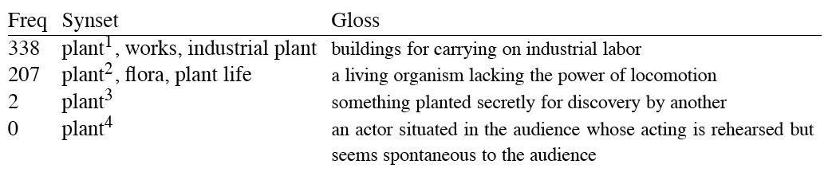
Most Frequent Sense
WordNet senses are ordered in frequency order
So “most frequent sense” in WordNet = “take the first sense”
Sense frequencies come from the SemCor corpus

Slide 29
Ceiling
Human inter-annotator agreement
Compare annotations of two humans
On same data
Given same tagging guidelines
Human agreements on all-words corpora with WordNet style senses
75%-80%

Slide 30
Word Sense Disambiguation
Dictionary and Thesaurus Methods

Slide 31
The Simplified Lesk algorithm
Let’s disambiguate “bank” in this sentence:
The bank can guarantee deposits will eventually cover future tuition costs because it invests in adjustable-rate mortgage securities.
given the following two WordNet senses:

Slide 32
The Simplified Lesk algorithm
Choose sense with most word overlap between gloss and context
(not counting function words)
The bank can guarantee deposits will eventually cover future tuition costs because it invests in adjustable-rate mortgage securities.

Slide 33
The Corpus Lesk algorithm
Assumes we have some sense-labeled data (like SemCor)
Take all the sentences with the relevant word sense:
These short, "streamlined" meetings usually are sponsored by local banks¹, Chambers of Commerce, trade associations, or other civic organizations.
Now add these to the gloss + examples for each sense, call it the “signature” of a sense.
Choose sense with most word overlap between context and signature.

Slide 34
Corpus Lesk: IDF weighting
Instead of just removing function words
Weigh each word by its `promiscuity’ across documents
Down-weights words that occur in every `document’ (gloss, example, etc)
These are generally function words, but is a more fine-grained measure
Weigh each overlapping word by inverse document frequency

Slide 35
Corpus Lesk: IDF weighting
Weigh each overlapping word by inverse document frequency
N is the total number of documents
df_{i} = “document frequency of word i”
= # of documents with word I

Slide 36
Graph-based methods
First, WordNet can be viewed as a graph
senses are nodes
relations (hypernymy, meronymy) are edges
Also add edge between word and unambiguous gloss words

Slide 37
How to use the graph for WSD
Insert target word and words in its sentential context into the graph, with directed edges to their senses
“She drank some milk”
Now choose the
most central sense
Add some probability to
“drink” and “milk” and
compute node with
highest “pagerank”

Slide 38
Word Sense Disambiguation
Semi-Supervised Learning

Slide 39
Semi-Supervised Learning
Problem: supervised and dictionary-based approaches require large hand-built resources
What if you don’t have so much training data?
Solution: Bootstrapping
Generalize from a very small hand-labeled seed-set.

Slide 40
Bootstrapping
For bass
Rely on “One sense per collocation” rule
A word reoccurring in collocation with the same word will almost surely have the same sense.
the word play occurs with the music sense of bass
the word fish occurs with the fish sense of bass

Slide 41
Sentences extracting using “fish” and “play”

Slide 42
Summary: generating seeds
Hand labeling
“One sense per collocation”:
A word reoccurring in collocation with the same word will almost surely have the same sense.
“One sense per discourse”:
The sense of a word is highly consistent within a document - Yarowsky (1995)
(At least for non-function words, and especially topic-specific words)

Slide 43
Stages in the Yarowsky bootstrapping algorithm for the word “plant”

Slide 44
Summary
Word Sense Disambiguation: choosing correct sense in context
Applications: MT, QA, etc.
Three classes of Methods
Supervised Machine Learning: Naive Bayes classifier
Thesaurus/Dictionary Methods
Semi-Supervised Learning
Main intuition
There is lots of information in a word’s context
Simple algorithms based just on word counts can be surprisingly good

